Slide 1

HTTP Security Headers You Need To Have On Your Web Apps
Slides up at scottsauber.com
scottsauber
Notes:
Connect to WiFi
dotnet watch run
Open localhost
https://nohstssecurityheaderstalk.azurewebsites.net/
https://hstssecurityheaderstalk.azurewebsites.net/
https://www.youtube.com/watch?v=2maaprwncgw
https://gist.githubusercontent.com/clarkio/32c7dba41dfb3418eaf1/raw/a1b8ea15238efa04a019923d4c04dd9294f15171/csp-harlem-shake-test.js

Slide 2

Audience
Anyone with a website/webapp
scottsauber

Slide 3
Agenda
What are HTTP Security Headers?
Why do they matter?
HSTS, XFO, XSS, CSP, CTO, RH, FP
What are they
What do they do
Demo
Impact on existing apps
scottsauber

Slide 4
Goals
Expose you to security headers that are out there
Why they are needed
Write down ones you need to look into when you’re back at work
scottsauber

Slide 5

Who am I?
Software Consultant
Co-organizer of Iowa .NET User Group
Friend of Redgate
Blog at scottsauber.com
Not a security expert… but…
scottsauber

Slide 6
What are HTTP Headers?
Allows both the client and server to pass additional data along to the request or response to exchange information and inform the other party.
Request header examples:
Cookies
Accept-language: en-us
Response header examples:
Date
Content-type: text/html or application/json
Security-related headers
scottsauber

Slide 7
What are HTTP Security Headers?
Response headers that the server responds with to instruct the browser what security rules to enforce when it handles your website’s content.
Key value pairs
In general, the more security headers you opt-in to sending, the more secure your website is.
Most security headers come with multiple options you can configure to tweak the behavior to what you want.
scottsauber

Slide 8
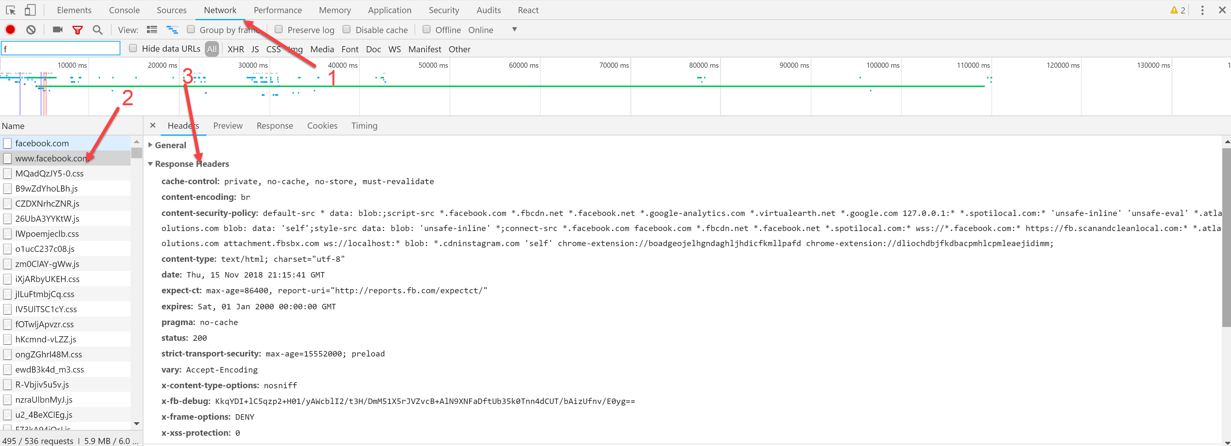
scottsauber

Slide 9
HTTP Strict Transport Security (HSTS)
What is it?
It allows websites to tell web browsers to only request this site over HTTPS, not over HTTP.
Why should I care?
Prevents some classes of man-in-the-middle (MITM) attacks.
scottsauber

Slide 10
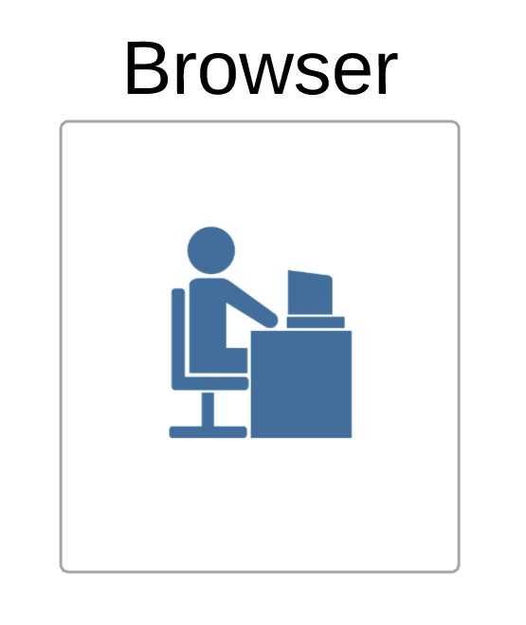
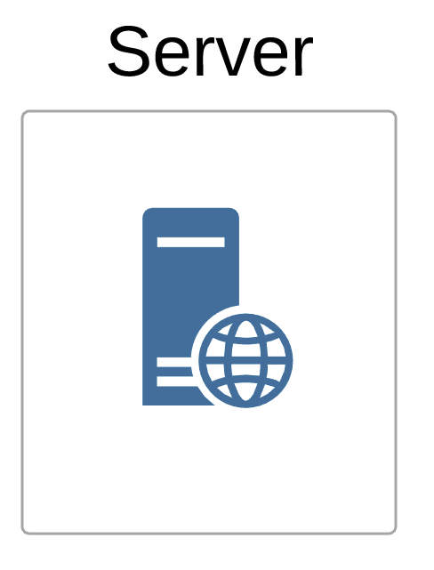
Without HSTS
scottsauber

Slide 11
What’s the issue?
scottsauber

Slide 12

What’s the issue?
scottsauber

Slide 13

What can happen?
scottsauber

Slide 14
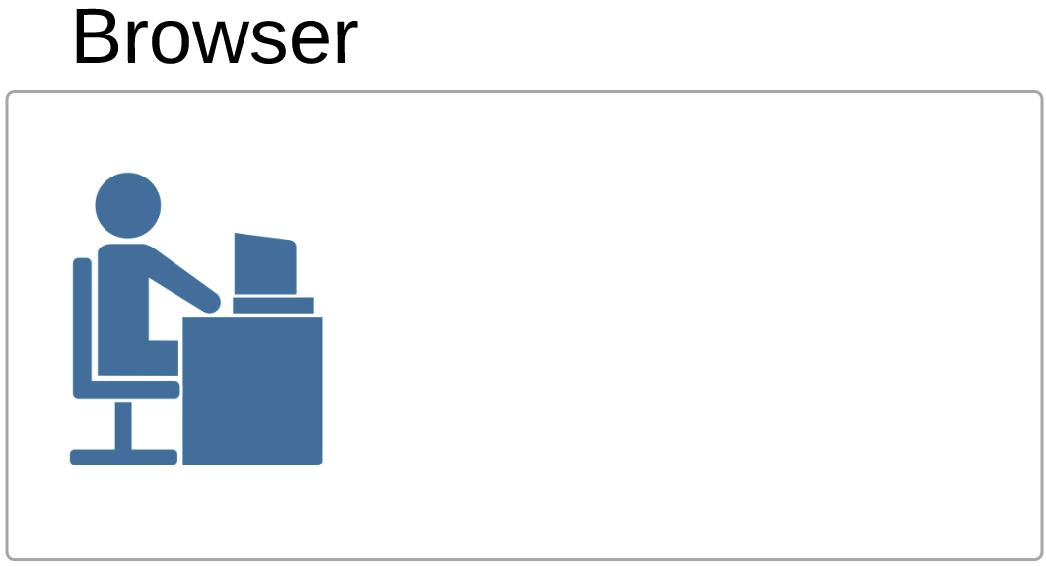
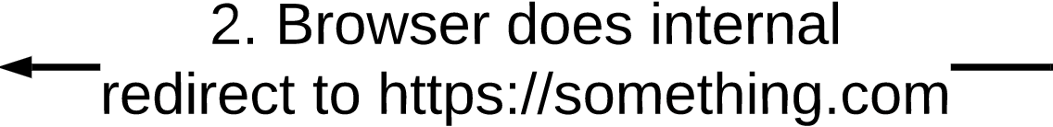
With HSTS
scottsauber

Slide 15
HSTS Options
Example:
max-age
The number of seconds the browser should enforce HSTS. 31,536,000 (1 year) is really common. Adds your site to its internal list for this # of seconds.
includeSubDomains
Apply the HSTS policy to all subdomains.
preload
Instructs the browser to be on the preload list… more on that in the next slide.
max-age is required. The other two are not.
scottsauber

Slide 16
HSTS Preload List
List maintained by Google, but used by all browsers.
If you ARE NOT on the list, then the first HTTP request will 301 and opens up for chance of MITM
If you ARE on this list, then the HTTP request will 307 internal redirect, not 301, even if you’ve never visited the site before
Guarantees no chance of basic MITM attack.
Submit your domain to the list here: https://hstspreload.org/
Add the preload option to your header to confirm your submission.
scottsauber

Slide 17

HSTS Demo
Notes:
https://nohstssecurityheaderstalk.azurewebsites.net/ – no HSTS
https://hstssecurityheaderstalk.azurewebsites.net/ – has HSTS

Slide 18
HSTS Gotchas
You probably don’t want this running when running locally on localhost… unless every website you run locally is HTTPS
HTTP and HTTPS often listen on different ports like localhost:5000 for HTTP and localhost:5001 for HTTPS.
If running for localhost:5000 it will redirect to https://localhost:5000 which will not bind
scottsauber

Slide 19
HSTS Impact of Retrofitting on Existing App
Is everything really HTTPS?
Subdomains
If you’re planning on going from HTTPS to HTTP in the future for some reason
IDK why though
scottsauber

Slide 20

Quick word on HTTPS
A good idea even if your site is internal
Network topology may change
Perception to users thanks to Chrome
scottsauber

Slide 21

HSTS Questions

Slide 22
X-Frame-Options (XFO)
What is it?
Used to tell a browser whether or not a page should be rendered in a frame or iframe.
Why should I care?
Prevents click-jacking attacks.
scottsauber

Slide 23

X-Frame-Options (XFO) Options
Example:
Directives to choose from
DENY
Prevents any domain from framing your page. This is the most secure.
SAMEORIGIN
Only allows framing from the same domain.
ALLOW-FROM http://site1.com
Let’s you specify a single site that can frame your page.
scottsauber

Slide 24
XFO Demo
Notes:
https://nohstssecurityheaderstalk.azurewebsites.net/ – no HSTS
https://hstssecurityheaderstalk.azurewebsites.net/ – has HSTS

Slide 25
XFO Impact of Retrofitting to Existing App
Do you know which sites should be iframing your app?
I imagine most could just do DENY or at least SAMEORIGIN
scottsauber

Slide 26
XFO Questions

Slide 27
Cross-Site Scripting (XSS)
What is it?
A vulnerability in a trusted website where malicious scripts can be injected.
XSS can be used to harvest cookies, tokens, etc. since the script that is loaded appears to be legit.
Often it comes from input from the user that is not validated or encoded and then re-displaying that to the user.
Examples:
Taking input from user, save it in a DB and others can see (Twitter, Facebook, etc.)
“Contact Us” or “Feedback” form on your page
Can you put in <script>//something malicious here</script> and does it get loaded by your email client?

Slide 28
XSS Demo
Notes:
https://nohstssecurityheaderstalk.azurewebsites.net/ – no HSTS
https://hstssecurityheaderstalk.azurewebsites.net/ – has HSTS

Slide 29
XSS Final Note
Most modern frameworks/browsers help you out here.
ASP.NET Core for instance, I have to call Html.Raw() since it encodes by default.
React escapes non-props characters by default
scottsauber

Slide 30
XSS Questions
Notes:
Any questions about XSS before we talk about how to prevent it

Slide 31
Cross-Site Scripting (XSS)
Can be prevented with Content-Security-Policy (CSP)
Among other attacks not just XSS
Old X-XSS-Protection security header is no longer honored by any major browser
scottsauber

Slide 32
Content Security Policy (CSP)
What is it?
Gives the browser an allowlist of sources to load static resources like JS, CSS, images, etc. from. This allowlist can specify how the resource is loaded (i.e. disabling inline scripts) and where the resource can be loaded from.
Why should I care?
It can reduce or even eliminate the ability for XSS to occur.
Also limits your attack surface of other kinds of attacks (more later).
scottsauber

Slide 33
Content Security Policy (CSP) Options
Example:
script-src = the content type you are configuring
self = the domain the page is being served on
The rest are other domains that are allowed to load scripts from
Other values:
unsafe-inline would mean allowing <script> tags or inline event handlers like <button onclick=“clickEvent”>
none means block any use of this content type
report-uri = where to send JSON payload with violation information

Slide 34
Content Security Policy (CSP) Options
In general, the more you allow, the greater your XSS risk.
Not allowing inline scripts is one of the biggest wins if you can manage it.
scottsauber

Slide 35
Content Security Policy (CSP) Options
There are other ones just like script-src that behave similarly such as:
style-src
media-src
frame-src
font-src
And more
All take in domains to allow
unsafe-inline also works with styles
none works with all
i.e. if you want no one to frame your content
scottsauber

Slide 36
CSP Demo
Notes:
https://nohstssecurityheaderstalk.azurewebsites.net/ – no HSTS
https://hstssecurityheaderstalk.azurewebsites.net/ – has HSTS

Slide 37
CSP Impacting of Retrofitting to Existing App
HUGE
This is an allowlist
You must know what your app is doing (inline scripts/styles or not), where it’s loading from (CDN’s, other sources, or not), etc.
Configuring this wrong will break your app.
Compromise
Set to report only (via Content-Security-Policy-Report-Only instead of Content-Security-Policy), collect data and what your app does, and tweak CSP to that accordingly after a certain period of time.
Start converting inline scripts and the like.
scottsauber

Slide 38
Content Security Policy (CSP)
CSP can override the need for other headers
frame-ancestors ‘none’ means no one can embed the page in a frame/iframe.
This eliminates the need for X-Frame-Options: DENY
scottsauber

Slide 39
CSP Questions
Notes:
Any questions about XSS before we talk about how to prevent it

Slide 40
Browser Sniffing Protection (X-Content-Type-Options)
What is it?
Tells a browser to not “sniff” the response and try and determine what’s in the response. Instead, look at the content-type header and render it according to that. So if it says it’s text/plain, render it as text/plain
Why should I care?
Prevents unexpected execution from what the server thinks the response is.
Especially important if you take uploads from a user and re-display them.
Someone may upload a .txt file, but it’s really JavaScript and without this option set, the browser may execute the JavaScript.
scottsauber

Slide 41
Browser Sniffing Protection (X-Content-Type-Options)
Example:
nosniff
Does not have the browser sniff the contents of the response to try and determine what to display
Instead, it just looks at the content-type header and renders it as that.
scottsauber

Slide 42
XCTO Impact of Retrofitting to Existing App
Very minimal
Note: most modern browsers will not sniff by default now.
IE in compatibility view will still sniff
Still shows up on audits
scottsauber

Slide 43
XCTO Questions
Notes:
Any questions about XSS before we talk about how to prevent it

Slide 44
Referer Header background
When a link is clicked, the browser will send the previous page’s URL in the Referer Request Header. Allows the server to do something with that data.
Useful for tracking a user’s flow through an app
Yes it’s misspelled
Yes that’s actually how it shows up in the browser
scottsauber

Slide 45
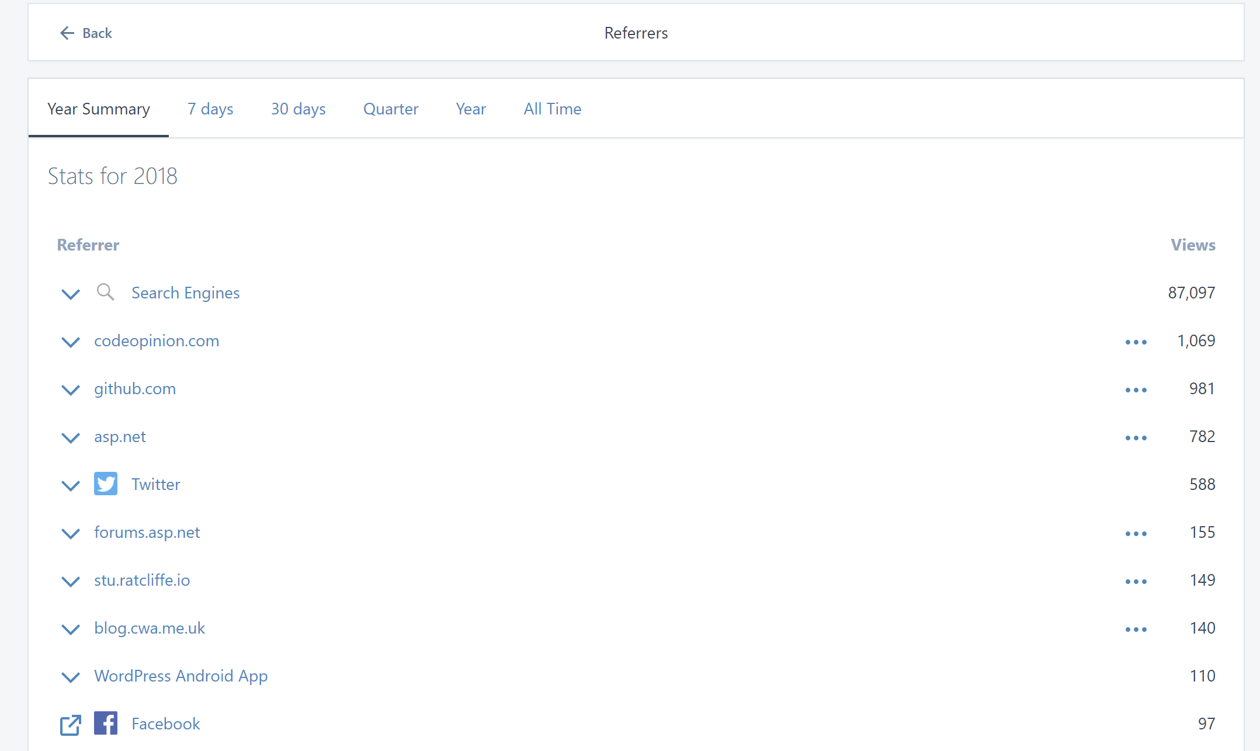
I’ve seen this on my blog

Slide 46
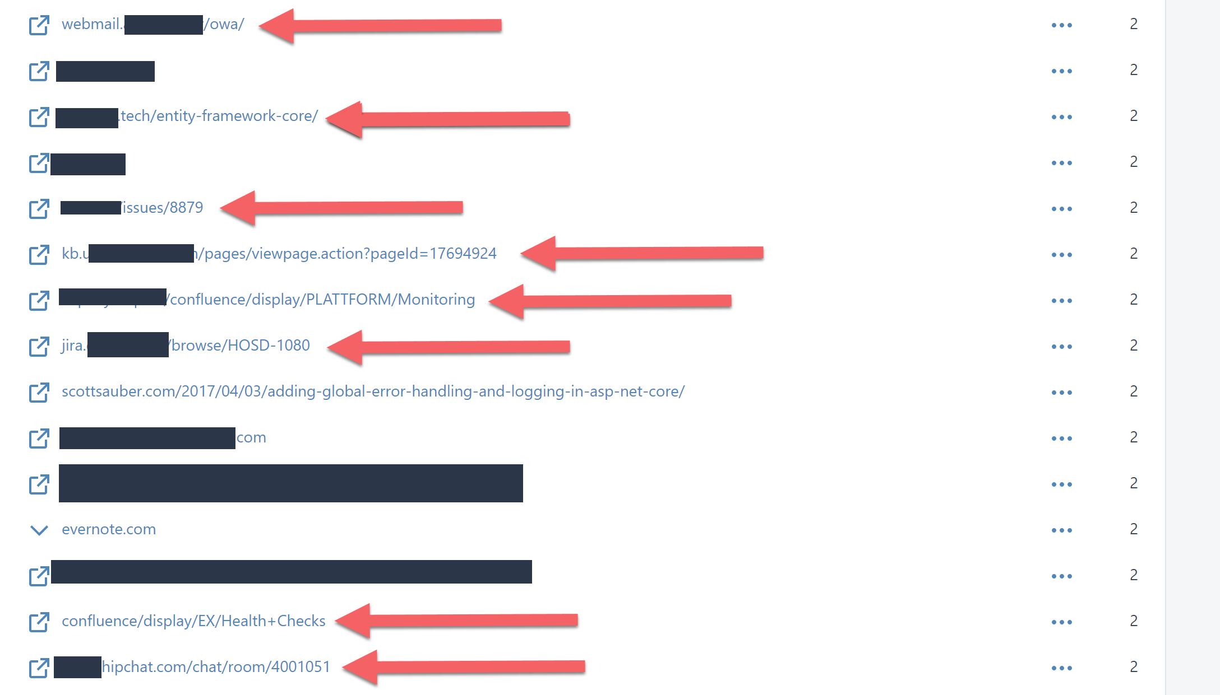
…and even JIRA/Confluence/OWA

Slide 47
Referrer-Policy
What is it?
Tells a browser what should be sent in the Referer header
Why should I care?
It helps protect the identity of the source of a page’s visit.
scottsauber

Slide 48
Referrer-Policy
Example:
no-referrer
Referer header is omitted entirely. Most secure.
origin
Only send the domain (i.e. sends example.com instead of example.com/index.html)
same-origin
Only send when going to the same domain
And more
scottsauber

Slide 49
RP Impact of Retrofitting to Existing App
Minimal with the right config
scottsauber

Slide 50
RP Questions
Notes:
Any questions about XSS before we talk about how to prevent it

Slide 51
Feature-Policy Is Experimental
What is it?
Tells a browser to allow or deny the use of browser features, and allowing granularity of being able to specify specific domains
Think – 3rd party code you embed.
Why should I care?
Allows you to restrict what your own app can do
In case of a XSS vulnerability
Allows you to restrict what 3rd party code can do
Block geolocation, camera, microphone, etc.
Limited browser support – rename coming to “Permissions Policy”

Slide 52
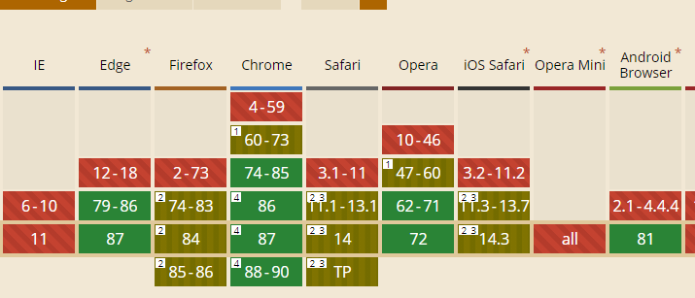
Feature-Policy Is Experimental

Slide 53
Feature-Policy
Example:
The feature you are locking down
camera, geolocation, microphone, payment, autoplay, etc.
The allow list of who can use this feature
*
self
none
https://example.com
scottsauber

Slide 54
FP Demo
Notes:
https://nohstssecurityheaderstalk.azurewebsites.net/ – no HSTS
https://hstssecurityheaderstalk.azurewebsites.net/ – has HSTS

Slide 55
FP Impact of Retrofitting to Existing App
Pretty big
Know what your site is doing
scottsauber

Slide 56
Permissions-Policy
Example:
Same idea as Feature-Policy but slightly different syntax
The feature you are locking down
The allow list of who can use this feature
scottsauber

Slide 57
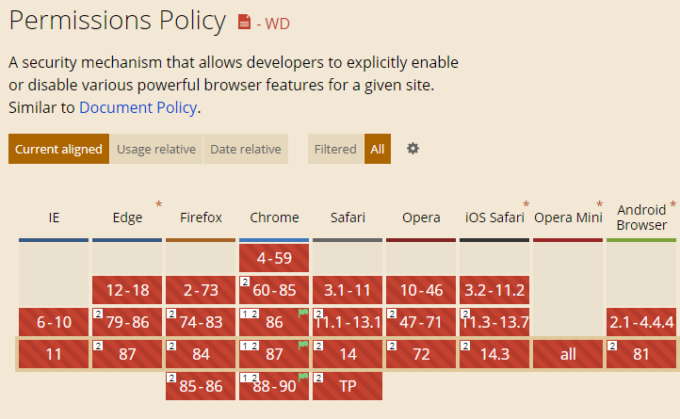
Permissions-Policy is… not there yet

Slide 58
FP/PP Questions
Notes:
Any questions about XSS before we talk about how to prevent it

Slide 59
How do I test my website?
https://securityheaders.com
Run by security expert Scott Helme
scottsauber

Slide 60
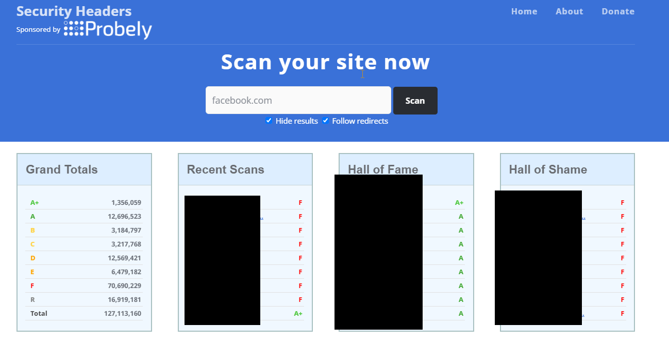
SecurityHeaders.com

Slide 61
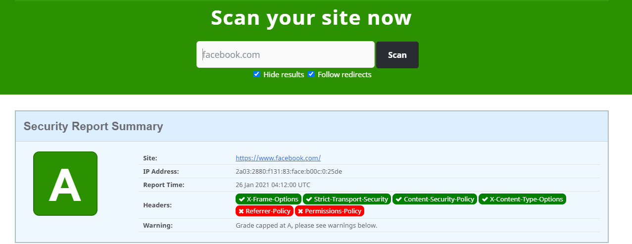
SecurityHeaders.com

Slide 62
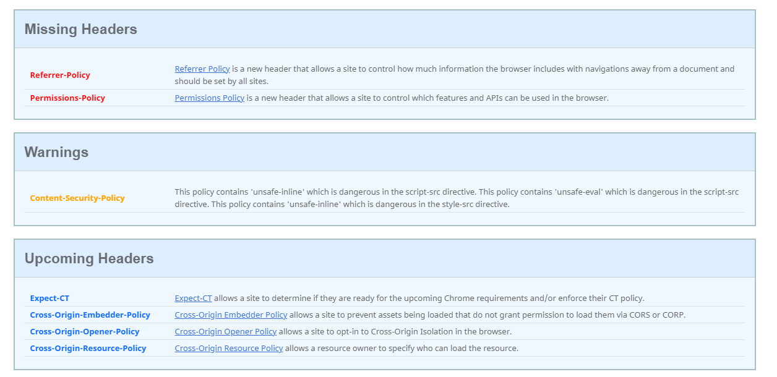
SecurityHeaders.com

Slide 63
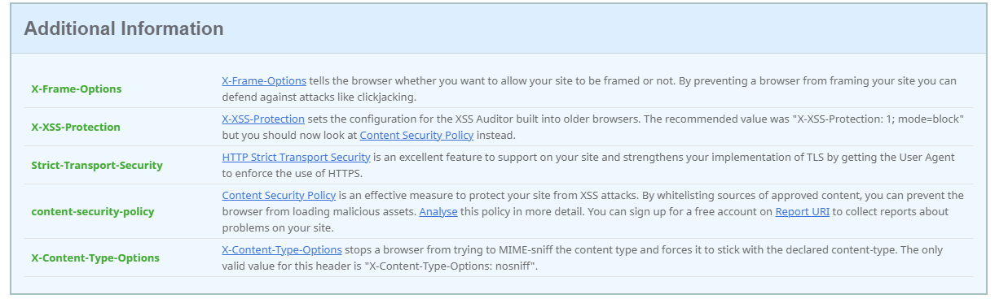
SecurityHeaders.com

Slide 64
Note
If you’re using a WAF (Cloudflare, Incapsula, etc.) they may be adding these for you.
Personally, I’d rather let the app add them, avoid vendor-lock in, and get localhost running as close to prod as possible.
Sometimes this is hard to do if doing JAM stack
Lambda@Edge
scottsauber

Slide 65
Takeaways
HTTP Security Header Awareness
At least one HTTP Header or option written down to look into at work
There are more Security Headers out there and more coming
SecurityHeaders.com
The web is a scary place
scottsauber

Slide 66
Resources
https://securityheaders.com/
MDN: https://developer.mozilla.org/en-US/docs/Web/HTTP/
Http Security on the left
Code from demos: https://github.com/scottsauber/security-headers-talk
Troy Hunt Pluralsight on Security Headers
scottsauber

Slide 67
Questions?
scottsauber

Slide 68
Thanks!
scottsauber

